Slide 1
Module 2:
Building Azure solutions using Azure Services
Notes:
Pictures and explanation has been adopted from Microsoft learn course and Microsoft website to help open-source community with free instructor led training

Slide 2

Module 2: Lesson 6:
Choose the best monitoring service for visibility, insight, and outage mitigation

Slide 3






About The Presenter
Mohammed Zaky
Senior Solution Developer
+5 years of experience in different industries (medical, educational, entertainment and maritime)
Microsoft Technologies expert (C# .Net, Azure)
Email: mzakielkassed@gmail.com

Slide 4


Lesson 5: Overview
This lesson will cover
Introduction
Identify your product options
Decision Criteria Analysis
Apply decision criteria to help chose the best tool in different scenarios
Prepare for The Exam(Q/A)

Slide 5
Choose the best monitoring service for visibility, insight, and outage mitigation
Introduction
Notes:
Modern software systems running in the cloud are complex, and gaining visibility into the health and performance of your application-hosting environment across all of its layers of services is challenging. Fortunately, there are several solutions from Microsoft that can help you react quickly to outages, research intermittent issues, optimize your usage, and be proactive in handling future planned downtime.
In this module, you'll learn about the several Microsoft monitoring solutions, and you'll analyze decision criteria that experts use to select the right service for a specific scenario.
Do you need to analyze how you're using Azure to reduce costs? Improve resilience? Harden your security?
Do you want to monitor Azure services or your usage of Azure?

Slide 6

The product options
Azure Advisor
Azure Service Health
Advisor is designed to help you save time on cloud optimization. The recommendation service includes suggested actions you can take right away, postpone, or dismiss.
provides a personalized view of the health of the Azure services, regions, and resources you rely on. The status.azure.com website, which displays only major issues that broadly affect Azure customers
Azure Monitor
is a platform for collecting, analyzing, visualizing, and potentially taking action based on the metric and logging data from your entire Azure and on-premises environment.
Notes:
At a high level, there are three primary Azure monitoring offerings, each of which is aimed at a specific audience and use case and provides a diverse set of tools, services, programmatic APIs, and more.

Slide 7
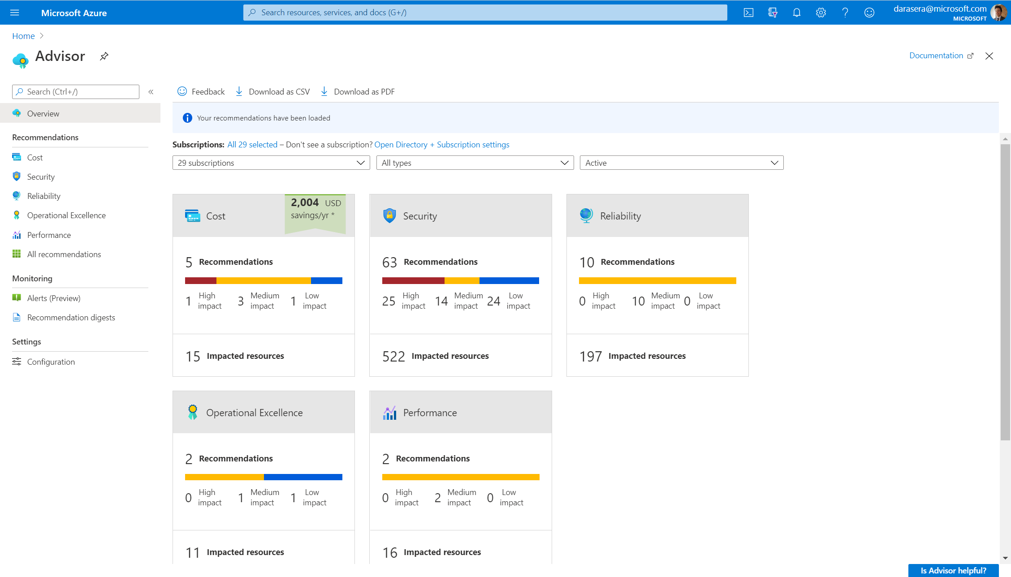
The product options - Azure Advisor
The recommendations are available via the Azure portal and the API, and you can set up notifications to alert you to new recommendations.
When you're in the Azure portal, the Advisor dashboard displays personalized recommendations for all your subscriptions, and you can use filters to select recommendations for specific subscriptions, resource groups, or services. The recommendations are divided into five categories:
Reliability: Used to ensure and improve the continuity of your business-critical applications.
Security: Used to detect threats and vulnerabilities that might lead to security breaches.
Performance: Used to improve the speed of your applications.
Cost: Used to optimize and reduce your overall Azure spending.
Operational Excellence: Used to help you achieve process and workflow efficiency, resource manageability, and deployment best practices.
Notes:
.

Slide 8
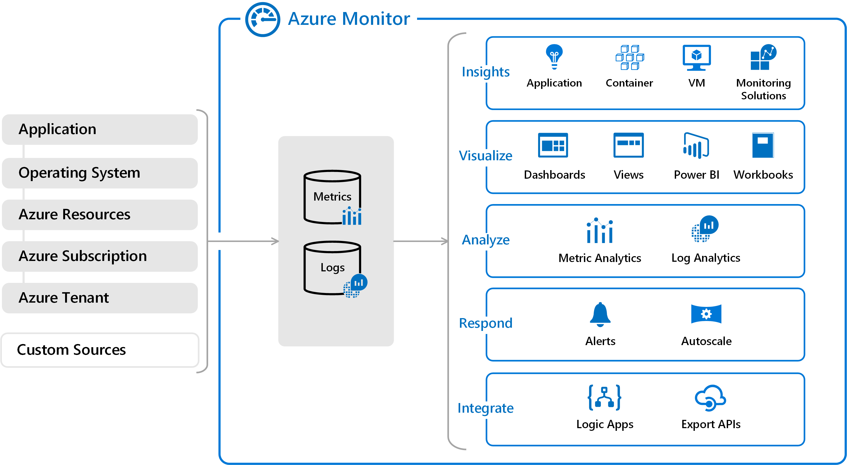
The product options - Azure Monitor
Notes:
.

Slide 9
The product options - Azure Monitor
on the left is a list of the sources of logging and metric data that can be collected at every layer in your application architecture, from application to operating system and network.
Notes:
.

Slide 10
The product options - Azure Monitor
In the center, you can see how the logging and metric data is stored in central repositories.
Notes:
.

Slide 11
The product options - Azure Monitor
On the right, the data is used in a number of ways. You can view real-time and historical performance across each layer of your architecture, or aggregated and detailed information. The data is displayed at different levels for different audiences. You can view high-level reports on the Azure Monitor Dashboard or create custom views by using Power BI and Kusto queries.
Notes:
Additionally, you can use the data to help you react to critical events in real time, through alerts delivered to teams via SMS, email, and so on. Or you can use thresholds to trigger autoscaling functionality to scale up or down to meet the demand.
--
Azure Application Insights
a service for sending telemetry information from application source code to Azure, uses Azure Monitor under the hood. With Application Insights, your application developers can take advantage of the powerful data-analysis platform in Azure Monitor to gain deep insights into an application's operations and diagnose errors without having to wait for users to report them.

Slide 12
Decision Criteria
Need to perform one-off management, administrative, or reporting actions?
Choose Azure Advisor when you're looking for an analysis of your deployed resources. Azure Advisor analyzes the configuration and usage of your resources and provides suggestions on how to optimize for reliability, security, performance, costs, and operations based on experts' best practices.
Do you want to monitor Azure services or your usage of Azure?
If you want to keep tabs on Azure itself, especially the services and regions you depend on, you want to choose Azure Service Health. You can view the current status of the Azure services you rely on, upcoming planned outages, and services that will be sunset. You can set up alerts that help you stay on top of incidents and upcoming downtime without having to visit the dashboard regularly.
However, if you want to keep track of the performance or issues related to your specific VM or container instances, databases, your applications, and so on, you want to visit Azure Monitor and create reports and notifications to help you understand how your services are performing or diagnose issues related to your Azure usage.

Slide 13
Decision Criteria
Do you want to measure custom events alongside other usage metrics?
Choose Azure Monitor when you want to measure custom events alongside other collected telemetry data. Custom events, such as those added in the source code of your software applications, could help identify and diagnose why your application is behaving a certain way.

Slide 14
Choose the best monitoring service for visibility, insight, and outage mitigation
Applying decision criteria to help chose the best tool in specific scenarios

Slide 15
Scenario 1
Tailwind Traders wants to optimize its cloud spend. Also, the organization is concerned about security breaches, because it stores customer data and historical purchase data in cloud-based databases. As the organization ramps up its cloud expertise, it wants to better understand its use of the cloud, better understand best practices, and pinpoint "easy wins" where it can tighten up its cloud spend and security practices.
Azure Advisor
Azure Monitor
Azure Service Health
Notes:
in this scenario, does Tailwind Traders need to analyze its Azure usage for the sake of optimization? Yes. Tailwind Traders understands that it might be spending too much, is concerned about its security practices, and wants to have its cloud usage analyzed against industry best practices. Therefore, Azure Advisor is the perfect option for this scenario.

Slide 16
Scenario 1
Tailwind Traders wants to optimize its cloud spend. Also, the organization is concerned about security breaches, because it stores customer data and historical purchase data in cloud-based databases. As the organization ramps up its cloud expertise, it wants to better understand its use of the cloud, better understand best practices, and pinpoint "easy wins" where it can tighten up its cloud spend and security practices.
Azure Advisor
Azure Monitor
Azure Service Health
Notes:
in this scenario, does Tailwind Traders need to analyze its Azure usage for the sake of optimization? Yes. Tailwind Traders understands that it might be spending too much, is concerned about its security practices, and wants to have its cloud usage analyzed against industry best practices. Therefore, Azure Advisor is the perfect option for this scenario.

Slide 17
Scenario 2
The Tailwind Traders e-commerce website is experiencing intermittent errors, and the team is unsure of the cause. Because of the nature of the errors, the team suspects that it's either a database or caching issue. What are the circumstances surrounding the errors? Does it happen only during peak usage times? What is the state of the team's Azure SQL instance? What is the state of its Redis caching server? How can it trace the issues to a root cause?
Azure Advisor
Azure Monitor
Azure Service Health
Notes:
, in this scenario, does Tailwind Traders need an analysis of its Azure usage for the sake of optimization? No, optimization isn't the team's objective in this scenario, so Azure Advisor isn't a candidate.

Slide 18
Scenario 2
The Tailwind Traders e-commerce website is experiencing intermittent errors, and the team is unsure of the cause. Because of the nature of the errors, the team suspects that it's either a database or caching issue. What are the circumstances surrounding the errors? Does it happen only during peak usage times? What is the state of the team's Azure SQL instance? What is the state of its Redis caching server? How can it trace the issues to a root cause?
Azure Advisor
Azure Monitor
Azure Service Health
Notes:
in this scenario, does Tailwind Traders need an analysis of its Azure usage for the sake of optimization? No, optimization isn't the team's objective in this scenario, so Azure Advisor isn't a candidate.

Slide 19




Prepare for The Exam (Q/A)
1. You want to be alerted when new recommendations to improve your cloud environment are available, which service will do this?
Azure Service Health
Azure Monitor
Azure Advisor
Notes:
The Azure Advisor alerts you when new recommendations are available

Slide 20
Prepare for The Exam (Q/A)
2. Which service provides official root cause analysis (RCAs) for Azure incidents ?
Azure Advisor
Azure Services Health
Azure Monitor
Notes:
Azure services health provides RCAs to share with stakeholders

Slide 21
Prepare for The Exam (Q/A)
3. Which service is a platform that powers Application Insights, Monitoring for VMs, containers and kubernetes
Azure Advisor
Azure Services Health
Azure Monitor

Slide 22

Summary
This lesson has covered
monitoring service for visibility, insight, and outage mitigation tools
Azure Advisor
Azure Monitor
Azure Services Health
Applied decision criteria to help chose the best tool in specific scenarios
Decision criteria Analysis
Use Azure Services Health for official root cause.
Use Azure Monitor to Get full stack visibility, find and fix problems, optimize your performance, and understand customer behavior all in one place
Use Azure Advisor to get an alert when new recommendations are available

